Slide 1

Social emotion mining techniques for Facebook reaction prediction
Florian Krebs, Bruno G. Lubascher, Tobias Moers, Pieter Schaap

Slide 2
Overview
1
Introduction
2
Prediction System
3
Visualisation
4
Conclusion

Slide 3
Overview
1
Introduction
2
Prediction System
3
Visualisation
4
Conclusion

Slide 4
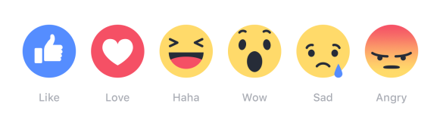
Dataset
Two datasets from Tesco and Sainsbury's (2016)
Note: after February 2016, reactions were introduced

Slide 5
Research Goals
Perform sentiment analysis and emotion mining on the posts/comments.
Do the emotions correct or boost the results of the second research goal?
Predict the distribution of user reactions.
Possible? Do the results make sense?

Slide 6
Overview
1
Introduction
2
Prediction System
2.1
Emotion Mining
2.2
Neural Networks
2.3
Prediction
3
Visualisation
4
Conclusion

Slide 7
Additional Data
Neural networks need huge amount of data for training
Original data not useful since most entries contain no reactions
-> Get more training data

Slide 8
Additional Data
Crawled additional data from Facebook of the most known supermarkets (e.g. walmart) and shops (e.g. Amazon)
The dataset increased from around 20k to 71k posts including 202k comments

Slide 9
Data analysis
Assertions:
Most of the data contains (almost) no reactions
The different reaction-types are roughly used with equal frequency
People's reactions are mostly the same to a certain topic

Slide 10
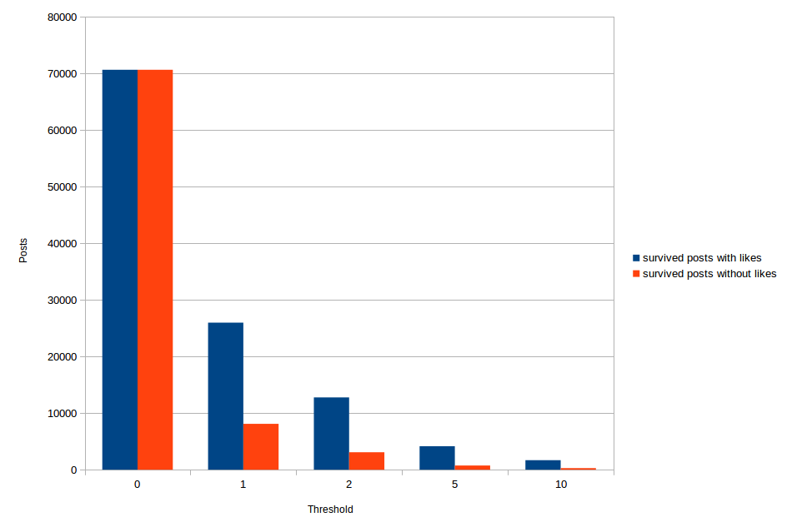
1. Data contains no reactions

Slide 11
1. Data contains no reactions
Decided to use threshold = 1

Slide 12
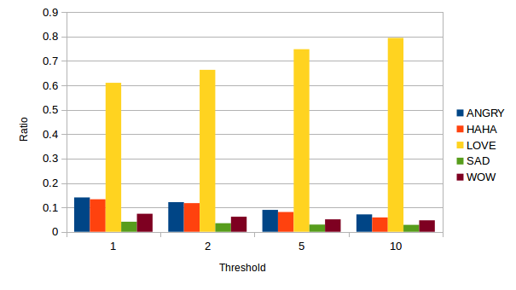
2. Equal usage frequency

Slide 13
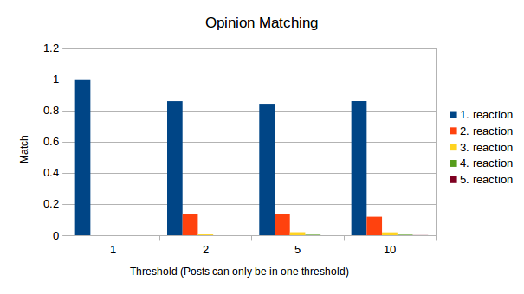
3. People agree on their reactions

Slide 14
Overview
1
Introduction
2
Prediction System
2.1
Emotion Mining
2.2
Neural Networks
2.3
Prediction
3
Visualisation
4
Conclusion

Slide 15
Sentiment analysis
Using Stanford CoreNLP to calculate sentiment for the post and comments (state of the art)
Techniques:
tokenize
sentence-split
PoS-tagging
parse (full syntactic analysis)
sentiment analysis (with negation handling)

Slide 16
Sentiment Analysis
CoreNLP calculates a sentiment for each sentence of the input
Very negative, negative, neutral, positive, Very positive
The sentiments are summed up and normalized by the number of the sentences
Ranges:
Negative: -2.0 to -0.5
Neutral: -0.5 to 0.5
Positive: 0.5 to 2.0

Slide 17
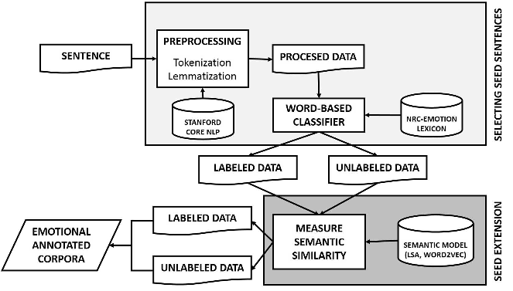
Emotion Mining
Source: (Canales, Strapparava, Boldrini & Martínez-Barco, 2016)

Slide 18
Emotion Mining
Data is split into sentences, tokenized and lemmatized
Using Stanford CoreNLP
The pre-processed data can be classified using a word-based approach with an emotion lexicon

Slide 19
NRC-Emotion Lexicon (EmoLex)
14,181 word-emotion associations
Emotions:
Anger, Anticipation, Disgust, Fear, Joy, Sadness, Surprise, Trust
Lexicon-entry
"abuse": [1, 0, 1, 1, 0, 1, 0, 0]
"shopping": [0, 1, 0, 0, 1, 0, 1, 1]

Slide 20
Bootstrapping EmoLex
Using WordNet synonyms to enhance the NRC-Emotion Lexicon.
Size increased from 14,181 to 31,485
Find synonyms with WordNet
Give them the same emotion vector and save in EmoLex

Slide 21
Word-based classifier
Find all emotion words and their emotion vectors of a sentence
Use negation handling to correct the emotion vectors
Sum up the corrected emotion vectors to get the final emotion score for this sentence

Slide 22
Negation handling
We created a mapping between an emotion and the negated emotion vector
E.g. anger: [1,0,0,0,0,0,0,0] is mapped to negated anger: [0,0,0,0,1,0,0,0] (Joy)
Negation list:
Negations: ["no", "not", "rather", "wont", "never", "none", "nobody", "nothing", "neither", "nor", "nowhere", "cannot", "without", "n't"]
Prefixes: ["a", "de", "dis", "il", "im", "in", "ir", "mis", "non", "un"]
Sufixes: ["less"]

Slide 23
Negation handling
Two rules:
Negation word is directly followed by an emotion word.
Using POS-Tags: a negation word is followed by one or more adverbs/past particle verbs (RB/VBN) and a following emotion word. Example: (“do not really really love”)
Afterwards: Sum up the new emotion vectors to get the final sentence emotions.

Slide 24
Emotion Mining
Source: (Canales, Strapparava, Boldrini & Martínez-Barco, 2016)

Slide 25
Sentence Similarity
Calculating sentence similarities:
Annotate non-annotated sentences that are similar (>0.8 similarity) with the same emotion vector
Example (using Word2Vec):
Sentence 1: “I really love your car.”
Sentence 2: I really hate your car.”
Average vector similarity: 0.9269

Slide 26
Emotion Mining
Using a one versus rest classifier with a linear SVM (multilabel) to annotate
the non-annotated sentences.
Source: (Canales, Strapparava, Boldrini & Martínez-Barco, 2016)

Slide 27
Support Vector Machine (SVM)
Use a linear SVM (with TF-IDF) and train it with the annotated sentences.
Using only the annotated sentences with a 95%-5% split for training and evaluating, we were able to achieve 93% average precision-recall.

Slide 28
Emotion Mining
The SVM was able to detect the emotions of the non-annotated sentences
Finally, the emotions to the Facebook posts of the dataset were able to be determined by summing up the sentence emotions

Slide 29
Overview
1
Introduction
2
Prediction System
2.1
Emotion Mining
2.2
Neural Networks
2.3
Prediction
3
Visualisation
4
Conclusion

Slide 30
Approach
Pre-processing
Filtering posts
Duplicate Characters
Classification
Recurrent Neural Network (RNN)
Convolutional Neural Network (CNN)
Notes:
Bruno

Slide 31






Models - RNN
RNN
I
Love
To
Shop
At
Tesco
!
LSTM cell
Dropout
Word
Embedding
LSTM cell
Dropout
Softmax
LSTM cell
Word embedding size : 50
LSTM cells : 128
LSTM layers : 1
Dropout probability : 0.5
Notes:
Bruno

Slide 32
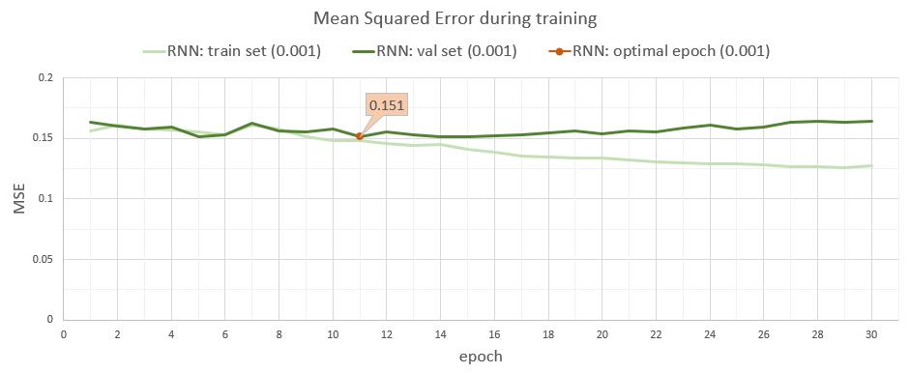
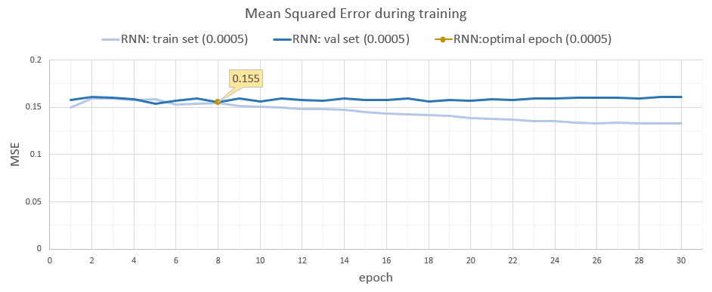
Models – RNN Training
Training vs Validation Mean squared error.
Select epoch when MSE started to deviate.
Notes:
Bruno

Slide 33
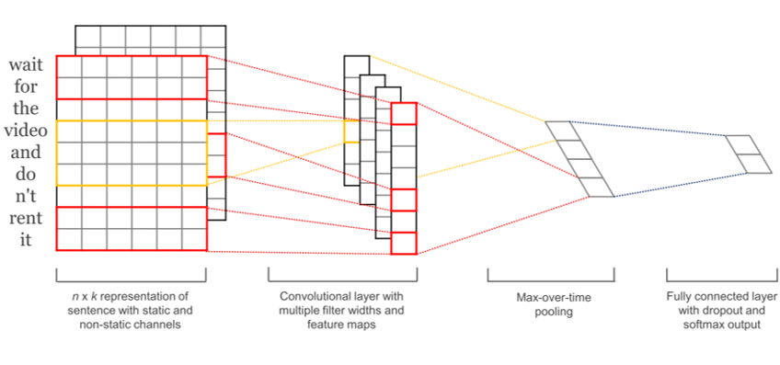
Models - CNN
Parameters:
Word embedding size: 50
Filter sizes : 3,4,5 words
Number of each filter: 40
Dropout probability: 0.5
Source: Kim, Y. (2014). Convolutional neural networks for sentence classification. CoRR, abs/1408.5882.
Notes:
Bruno

Slide 34
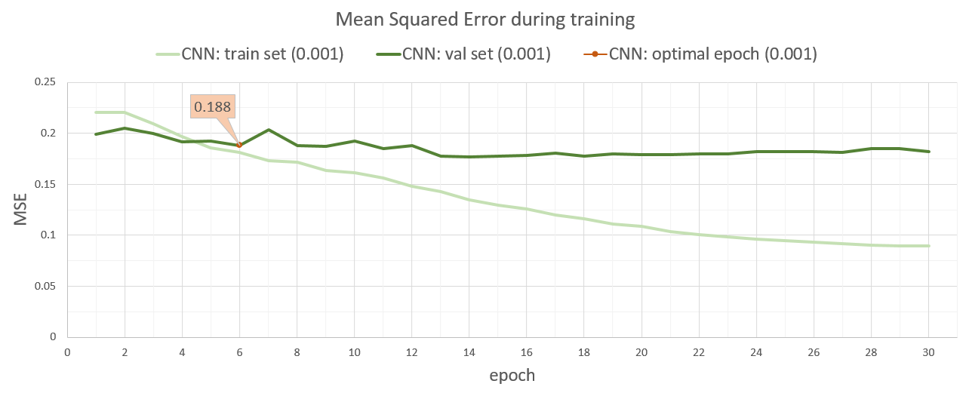
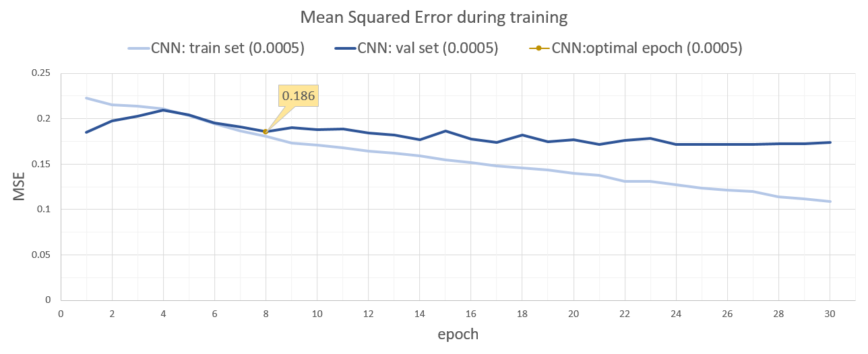
Models – RNN Training
Training vs Validation Mean squared error.
Select epoch when MSE started to deviate.
Notes:
Bruno

Slide 35
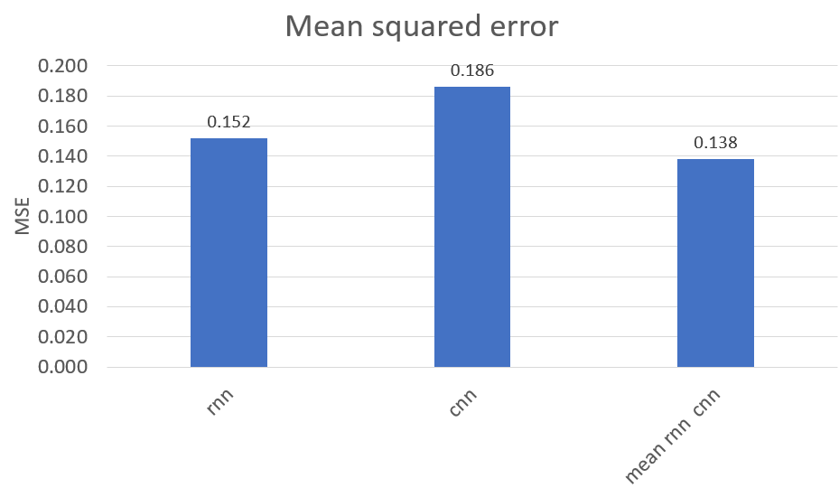
RNN vs CNN
Independently, the RNN outperforms the CNN.
Together, they are more accurate.
Notes:
Bruno

Slide 36
Overview
1
Introduction
2
Prediction System
2.1
Emotion Mining
2.2
Neural Networks
2.3
Prediction
3
Visualisation
4
Conclusion
Notes:
Bruno

Slide 37
Prediction
Pre-processing
Processing
Emotion Mining
CoreNLP
Linear Regression
POST
CNN
GloVe word embeddings
Mean
RNN
Notes:
Bruno

Slide 38
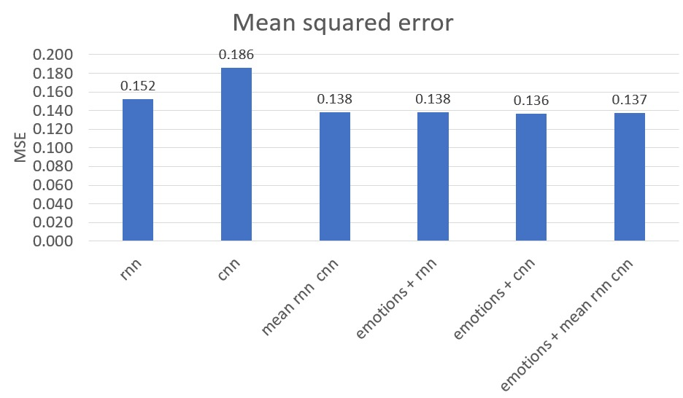
Prediction
Notes:
Bruno

Slide 39
Overview
1
Introduction
2
Prediction System
3
Visualisation
4
Conclusion
Notes:
Pieter

Slide 40
Visualisation
Html-Javascript tool
Input: text/post
Output:
Distribution of reactions
Detected emotions
Emotion word highlighting
Sentiment highlighting
Notes:
Pieter

Slide 41
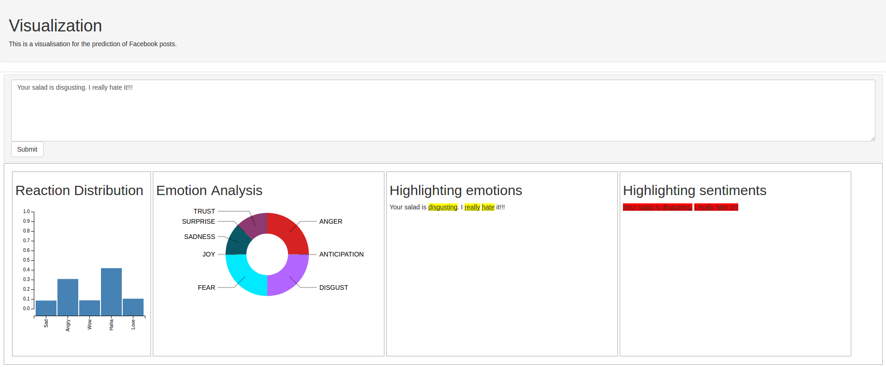
Live Demo
Notes:
Pieter

Slide 42
Overview
1
Introduction
2
Prediction System
3
Visualisation
4
Conclusion
Notes:
Pieter

Slide 43
Conclusion
Research goals:
Perform sentiment analysis and emotion mining on the posts/comments
Do the emotions correct or boost the results of the second research goal?
Predict the distribution of user reactions
Possible? Do the results make sense?
Notes:
Pieter

Slide 44
Sentiment analysis & Emotion mining
Created a pipeline to analyze the sentiment and emotions in a sentence
Added negation handling to improve results
The emotions improved the predicted reactions slightly
Notes:
Pieter

Slide 45
Facebook Reaction prediction
Implemented two neural networks
Both can predict the distribution of the reactions for a post
Combining the results of the two networks improved the result
Notes:
Pieter

Slide 46
Additional achieved goals
Built an easy-to-use web application that displays the sentiment, emotions and reaction predictions to a post
Increased size of emotion lexicon
Created Facebook data crawler which enabled us to build a big dataset
Notes:
Pieter

Slide 47
Future Work
Parameter tuning of networks
More detailed evaluation of the emotion and sentiment miner with MPQA corpus
Prediction of absolute numbers for each reaction-type
Notes:
Pieter

Slide 48
References
Perez-Ortiz, J. A., Calera-Rubio, J., and Forcada, M. L. (2001). Online text prediction with recurrent neural networks. Neural Processing Letters, 12:127-140.
Rehurek, R. and Sojka, P. (2010). Software Framework for Topic Modelling with Large Corpora. In Proceedings of the LREC 2010 Workshop on New Challenges for NLP Frameworks, pages 45-50, Valletta, Malta. ELRA. http://is.muni.cz/publication/884893/en.
Schare, F. (2017). Word2Vec pretrained models.
Sun, S., Luo, C., and Chen, J. (2016). A review of natural language processing techniques for opinion mining systems. Elsevier, 34:10-25.
Zhang, L. and Liu, B. (2014). Aspect and Entity Extraction for Opinion Mining, pages 1-40. Springer Berlin Heidelberg, Berlin, Heidelberg.
Arathi, M. Solving text imputation using recurrent neural networks.
Facebook (2016). Reactions now available globally. http://newsroom.fb.com/news/2016/02/reactions-now-available-globally/. Accessed: 2017-03-14.
Fan, W. and Gordon, M. D. (2014). The power of social media analytics. Commun. ACM, 57(6):74{81.
Kalchbrenner, N., Grefenstette, E., and Blunsom, P. (2014). A convolutional neural network for modelling sentences. CoRR, abs/1404.2188.
Kim, Y. (2014). Convolutional neural networks for sentence classication. CoRR, abs/1408.5882.
Klec, M. (2012). Sparse autoencoders in sentiment analysis. PolTAL '14, Warsaw, Poland.
Lai, S., Xu, L., Liu, K., and Zhao, J. (2015). Recurrent convolutional neural networks for text classication.

Slide 49
Questions?

Slide 50
Backup: New Agenda

Slide 51
Contribution – Period 6
Tobias:
CNN, Sentiment analysis and Emotion Mining, visualization, experiments, report, presentation, research
Florian:
Sentiment analysis and Emotion Mining, data crawling, visualization, API, report, presentation
Bruno:
RNN, CNN, Regression, experiments, report, presentation
Pieter:
Data filtering, visualization, report, presentation

Slide 52
Backup: Negation Handling
One example of the emotion vector calculation when using negation handling:
Emotion of a word: [0,0,1,1,0,1,0,0]
New emotion after negation of "Disgust": [0,0,0,0,0.5,0,0,0.5]
New emotion after negation of "Fear": [0,0,0,0,1.0,0,0,1.0]
New emotion after negation of "Sadness": [0,0,0,0,2.0,0,0,1.0]

Slide 53
Model configuration comparison
Goal: Determine influence of model structure (CNN vs RNN).
Setup: Train both CNN and RNN networks and compare their mean squared errors.
Errors are computed on a pre-defined split.

Slide 54
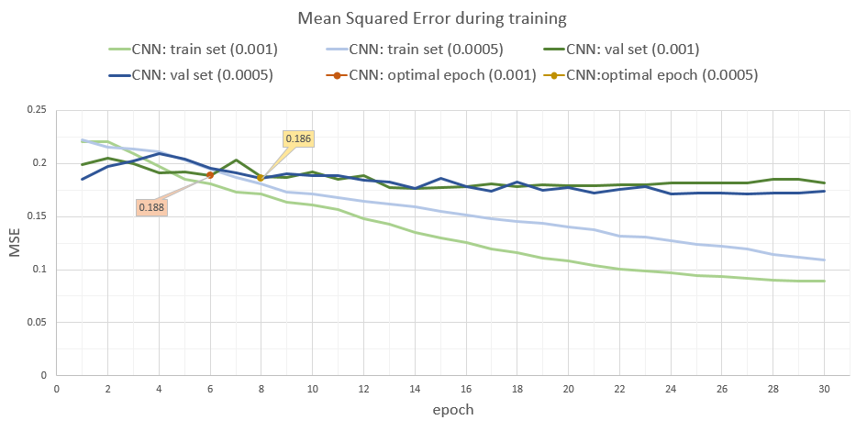
Model configuration comparison
Results CNN

Slide 55
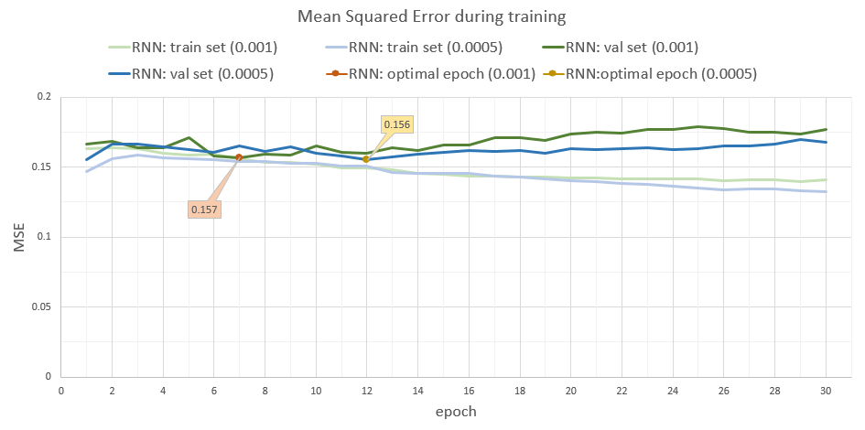
Model configuration comparison
Results RNN

Slide 56
Model configuration comparison
RNN outperforms CNN
CNN requires less epochs

Slide 57
Experiments
Raw input vs pre-processed input
Compare different filtering criteria
Minimum number of reactions
Ignore likes
Model configuration comparison

Slide 58
Filter: Minimum number of reactions
Goal: Use only those posts for training that have a certain amount of total reactions (e.g. 15)
Setup:
Filter for all posts in the DB that have the required amount of total reactions
Give some information about the size of the filtered data
Hypothesis: The higher the amount of reactions the more meaningful are the distributions of those posts. The drawback of this method is the reduced amount of training data

Slide 59
Filter: Minimum number of reactions
Results:
When using posts with at least 15 total reactions only ~200 Posts are left
When using the additional crawled material we still only got around ~475 posts
Those are way too less to train a NN efficiently

Slide 60
Raw input vs pre-processed input
Goal: check the effect that the pre-processing has on the accuracy of the model.
Setup: Train a model with raw-data as input and compare it to the model trained with pre-processed data.
Hypothesis: pre-processed input should outperform the raw input.
Pre-processing decreases the corpus’s vocabulary.
Pre-processing should decrease noise created by typo’s and character repetition.

Slide 61
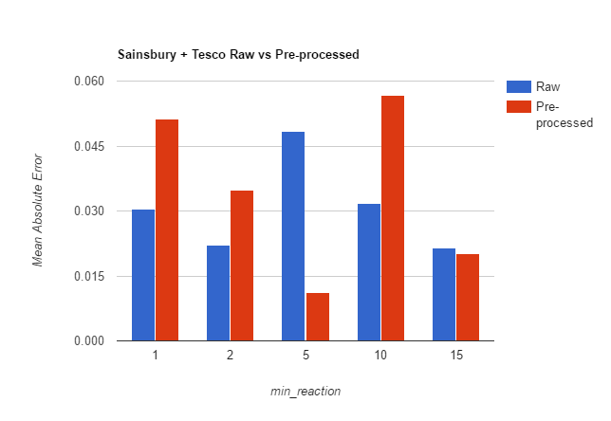
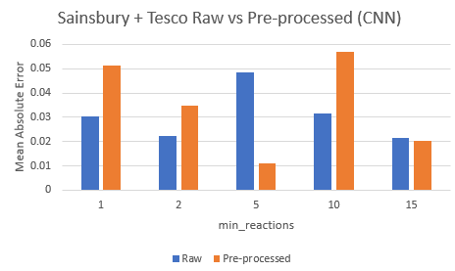
Raw input vs pre-processed input
Results CNN
Pre-processing overall increases error.
Sensitive to fewer word variance.

Slide 62
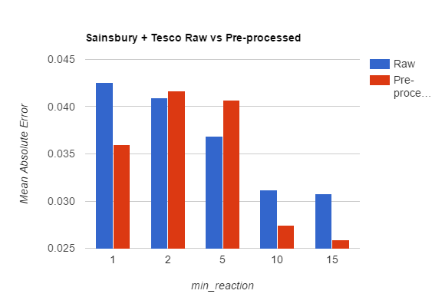
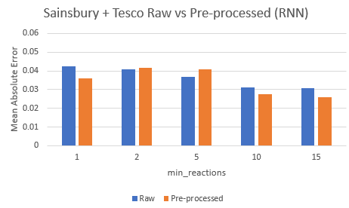
Raw input vs pre-processed input
Results RNN
Pre-processing helped to decrease error.
More robust to fewer word variance.

Slide 63
Filter: Ignore likes
Goal: Remove likes from training data to reduce the problem of poorly distributed data
Setup:
Get all posts from DB but ignore/remove the likes from the distribution when training the model
Hypothesis: The accuracy of the reactions' predictions should increase since the distribution is now more consistent

Slide 64
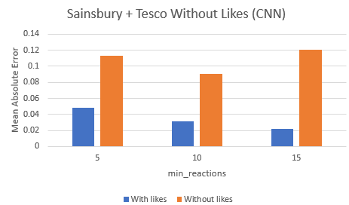
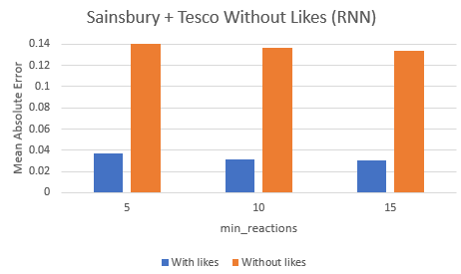
Filter: Ignore likes
Results CNN/RNN
Discarding likes decreases accuracy. Simple explanation: Like ratio close to 1 Always predicting likes to be 100% will lead to lower errors but carry little information.

